Slide 1

Rice University Data Analytics Boot Camp
Project 1 - Information, Insights, and Analysis from the City of Los Angeles – Crime – 2010 through 2018
Frederik De Bruyker / Ehsan Khan / Jeff Mackey

Slide 2
Top Violent Crimes Disparity by Zip Code
Top 10% account for 43.66 %
Top 20 % account for 65.19 %

Slide 3
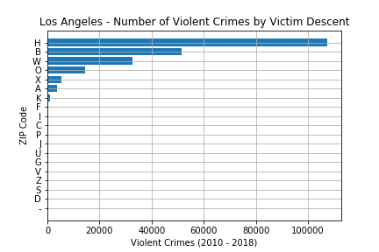
Expectation versus Data: Violent Crime Victim Descent
Expectation:
Close % of Hispanic / Black victims
Data:
49.56 % of Hispanic descent
Black / White crime not dramatically different
Descent | Percentage
Hispanic | 49.56%
Black | 23.80%
White | 15.10%

Slide 4
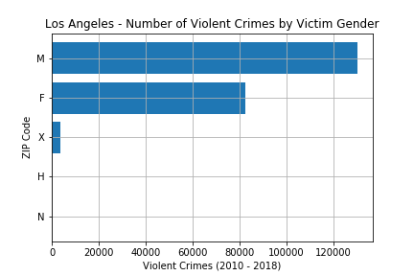
Expectation versus Data: Violent Crime Victim Gender
Expectation:
Higher % of female victim
Data:
60.15% are male

Slide 5

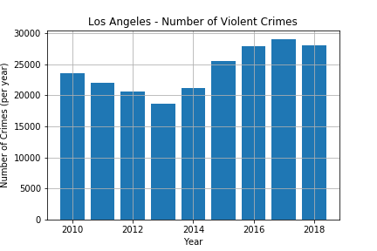
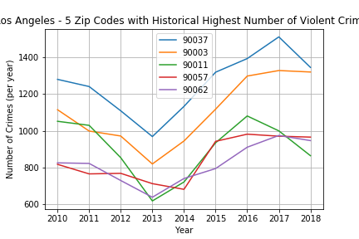
News Validation: 2018 versus 2017 : Overall Violent Crime
News article:
Violent crime: 2018: 27,246
Decrease of near to 4 %
https://www.latimes.com/local/lanow/la-me-lapd-crime-stats-20181229-story.html
Analysis:
Violent crime: 2018: 27,991 (from 2017: 29,045)
Decrease of 3.63 %

Slide 6
News validation: Issues
No fixed definition of violent crime
Analysis only as good as underlying data
Stark local differences
Changing perception
Notes:
No fixed definition of what constitutes violent crime
The LA Times article describes violent crime as 'violent crime — which includes homicide, rape, robbery and aggravated assault‘
Efforts on going to classify crime (https://www.nap.edu/read/23492/chapter/7#121)
The data analysis can only be as good as the underlying data
The LA Times article states that more then 25,000 serious crimes were classified as minor
https://www.latimes.com/local/crime/la-me-lapd-audit-20151206-story.html
Overall conclusion violent crime decrease sounds good, but local stark differences
How to account for changing perception of what constitutes a crime and/or what people consider ‘normal/acceptable’ behavior over time

Slide 7
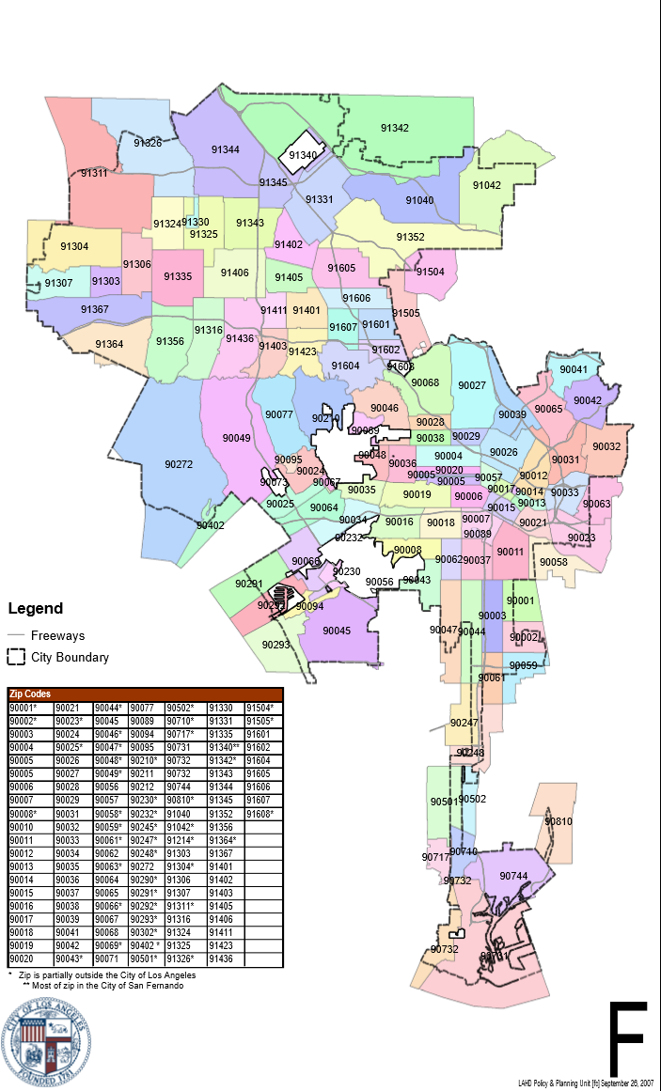
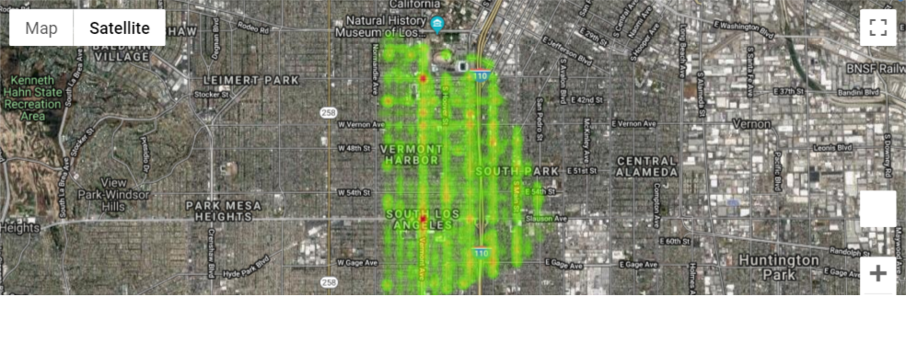
Which zip codes not to live in LA?
90037, 90003, 90011, 90057, 90062

Slide 8
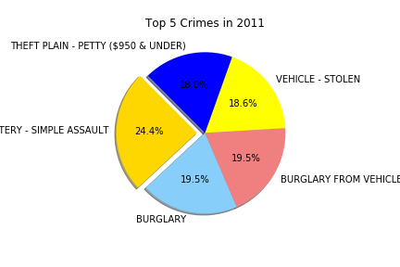
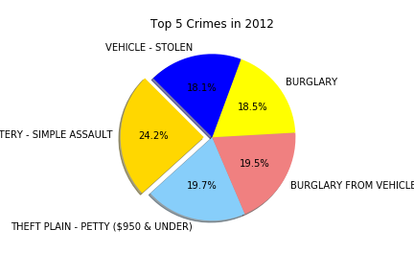
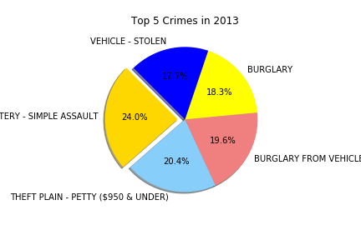
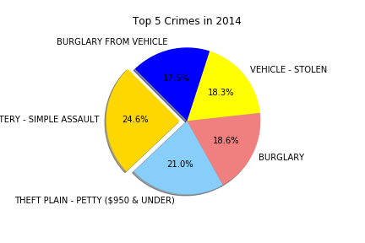
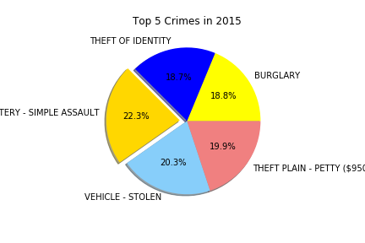
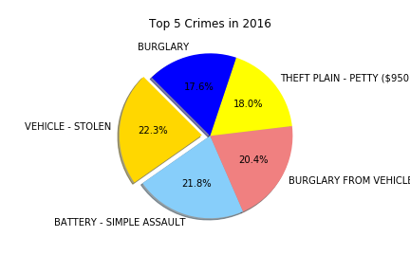
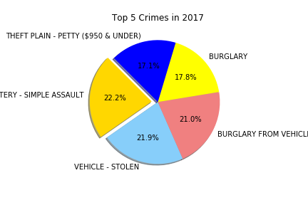
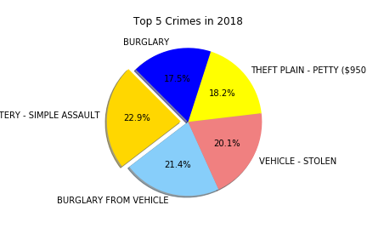
Are the top crime changing?

Slide 9
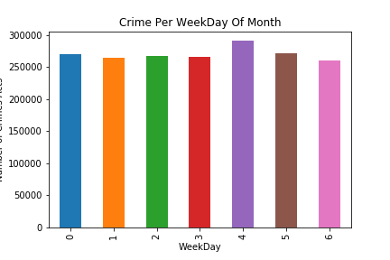
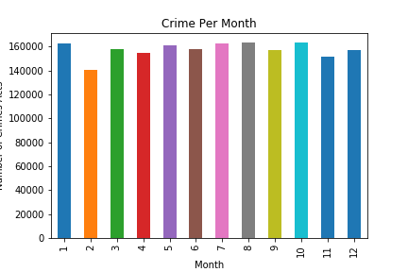
Are Some Months/Days Safer for Los Angeles Residents?

Slide 10
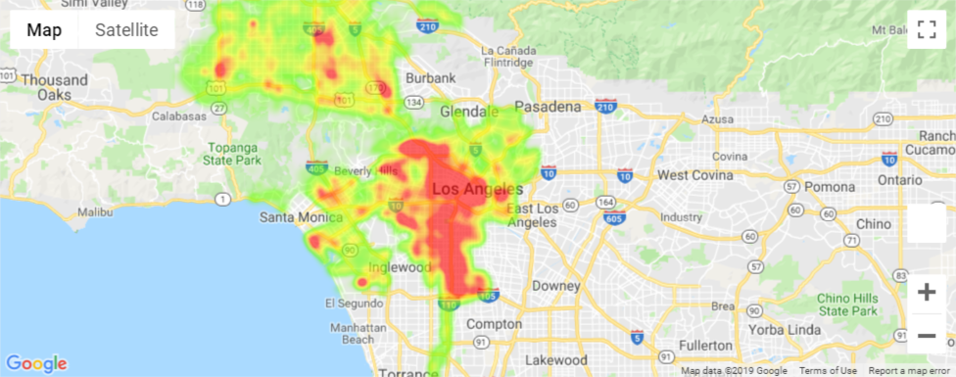
Is It Safe to Live in Los Angeles? Total Reported Crimes in 2018: 225811 Total Population: 4.01 millions estimated

Slide 11
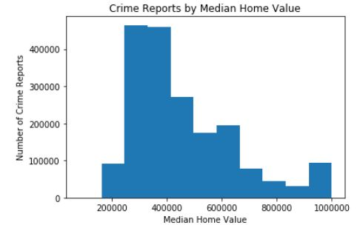
Effects of Property Values on Crime Rates

Slide 12
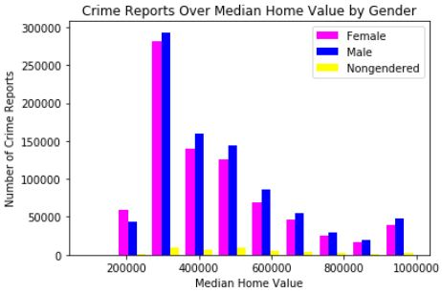
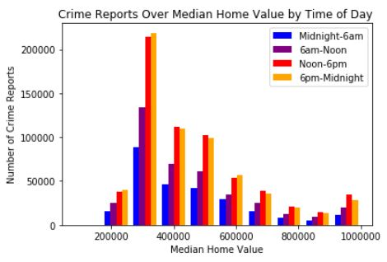
Effects of Property Values on Crime Rates: Other Views

Slide 13
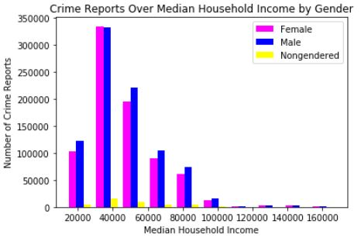
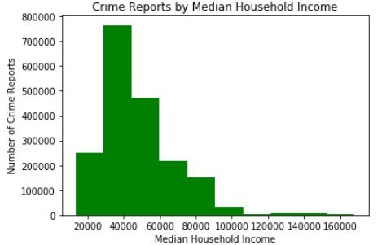
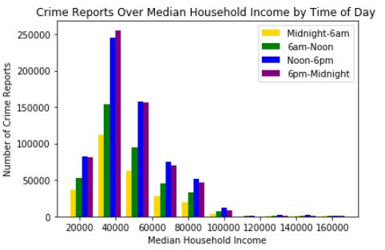
Effects of Median Income on Crime Rates

